Slide 1
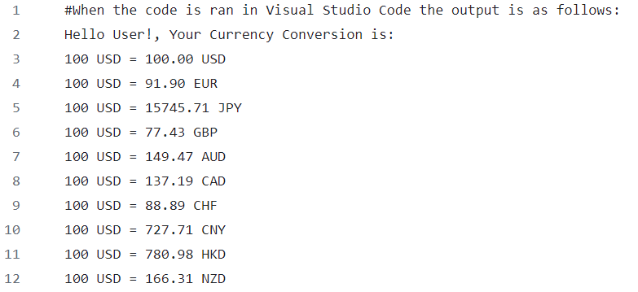

Currency Converter
A quick and easy way to convert currency using multiple worldwide currencies. Using a base amount of 100 USD, the consumer can find the conversion rate for the top 10 currencies: USD, EUR, JPY, GBP, AUD, CAD, CHF, CNY, HKD, and NZD.
Taylor Bates
This code was run using Python (3.11.7)

Slide 2
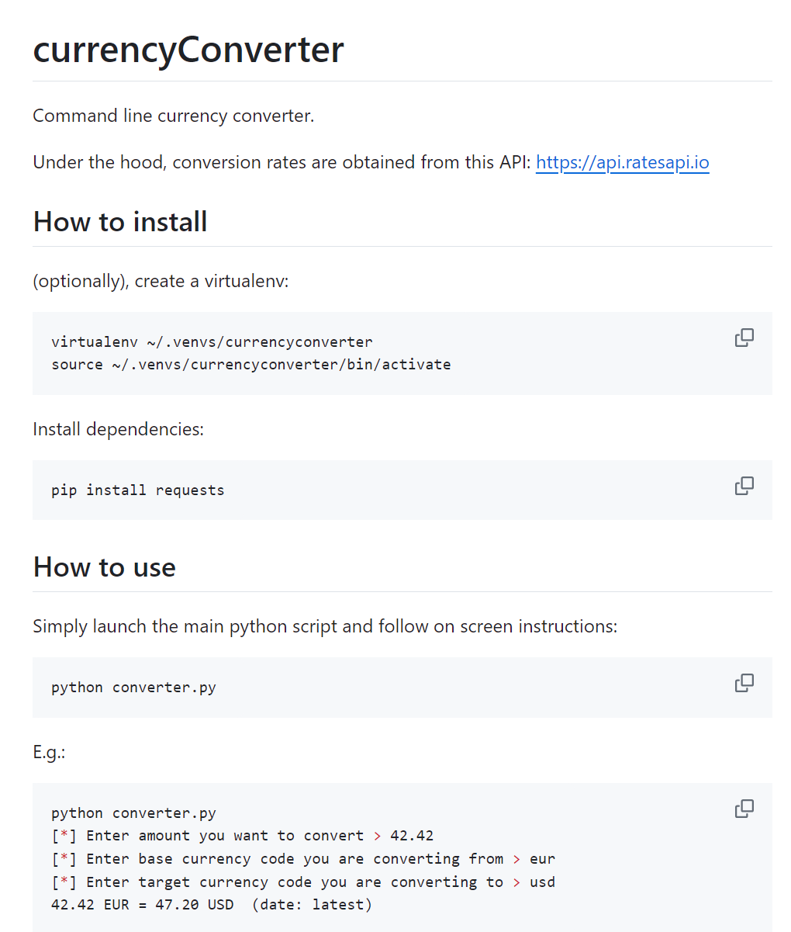
Source code/tutorials
EXAMPLE CODE
https://github.com/snifhex/currencyConverter --> This example is what led me to using API Exchange Rates
https://www.youtube.com/watch?v=fJKdIf11GcI --> This YouTube tutorial helped me learn how to install Pip and Requests
Used AI to help with specifics of the code functions

Slide 3
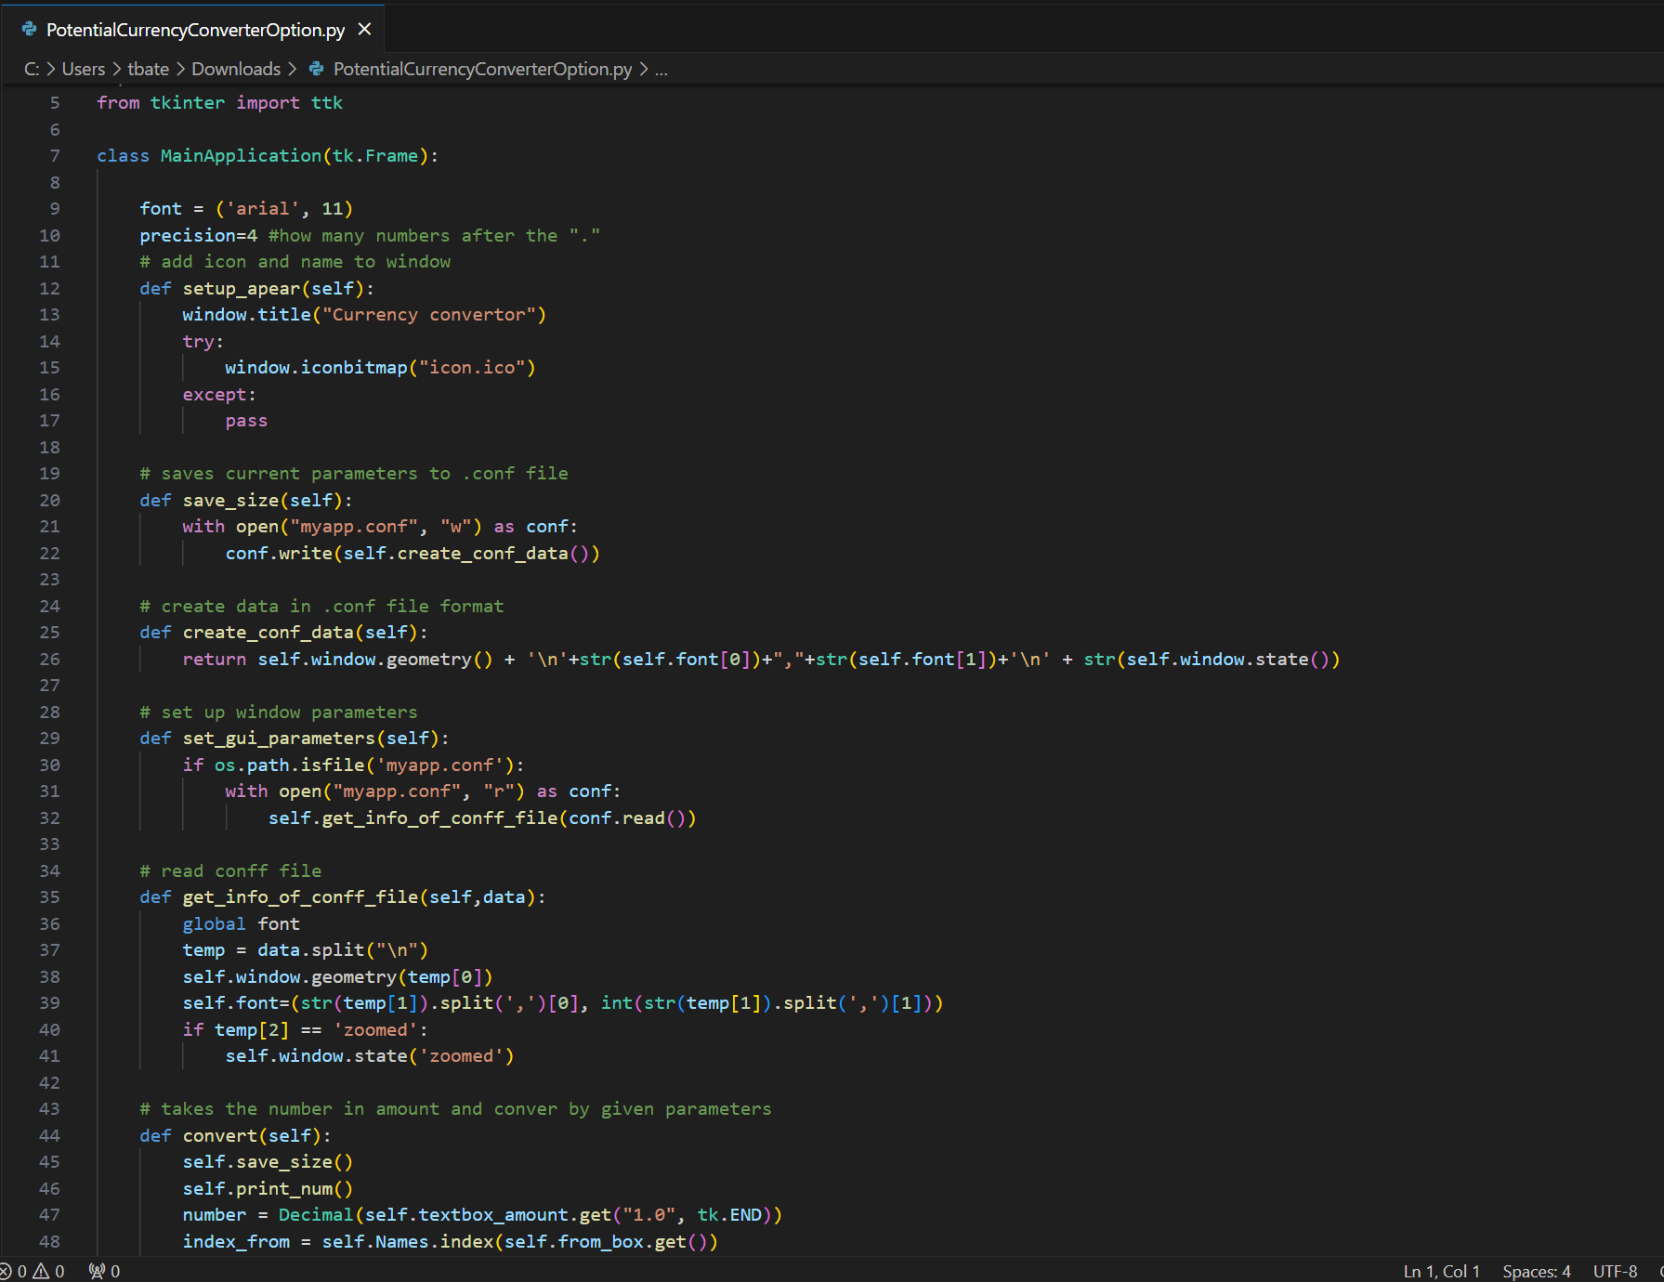
Project development
What surprised me? What changed? Roadblocks?
SPRINT 1
Originally had plans to create a website generator but could not find a code that worked in VSC
SPRINT 2
Decided to switch gears and just focus on finding a code that worked
SPRINT 3
Made last minute developments to ensure the code was flawless and accurate

Slide 4
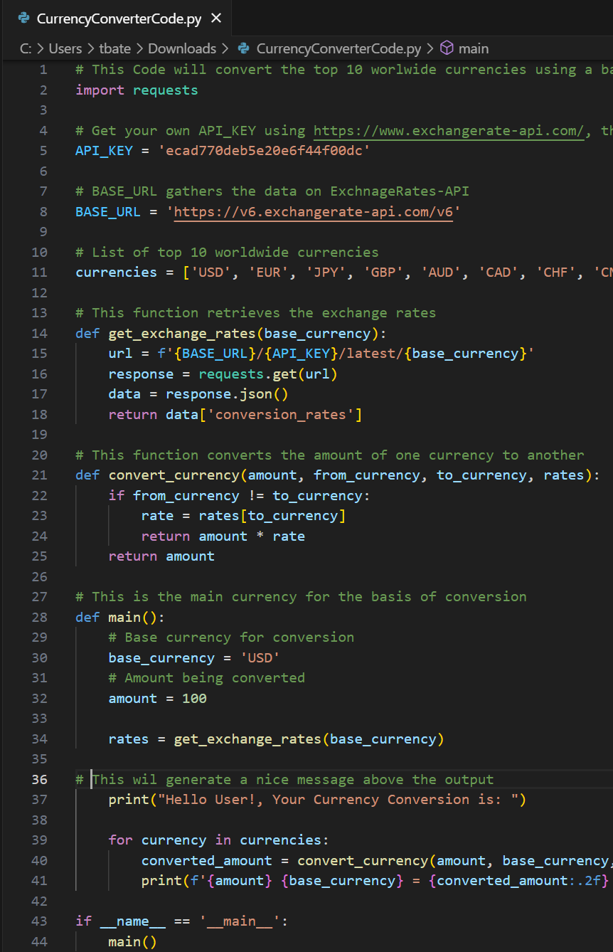
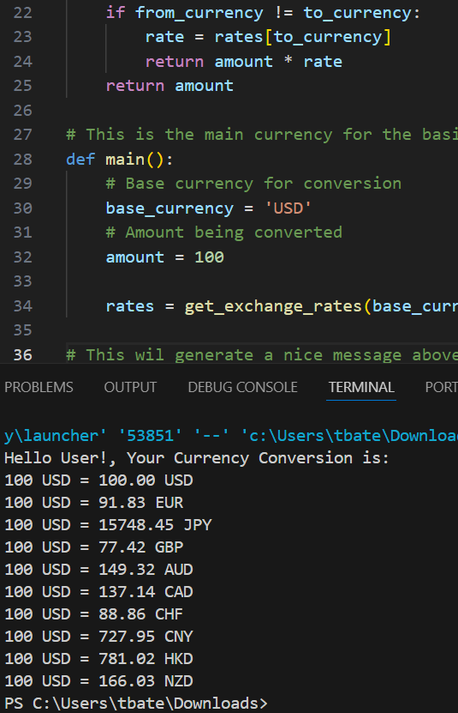
The code & What’s next
The code runs smoothly
If the project were to continue, I would do more research on how to turn the code into a website converter that would allow users to input any amount instead of just a base amount
INPUT OUTPUT

